Slide 1





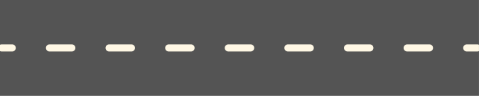
TECHTURTLES
Courier Service System
Presented By
MUHAMMAD NUR AZHAR BIN MOHD YAZID
MUHAMMAD DANIEL HAKIM BIN SYAHRULNIZAM
MUHAMMAD SAFWAN BIN MOHD AZMI

Slide 2


About Us
We are commited to make this project.
We are all 2nd Year Data Engineering students taking Data Structure and Algoritm, with all of us passionate to present this project to all of you.

Slide 3


Contents
1
Objective
3
Design
2
Synopsis
4
Implementation

Slide 4

Objective
Our project is aiming:
To utilize a stack and queue operations to manage packages, the administrator can add new packages with information like the tracking number, address, sender, recipient, category, and delivery status, among other tasks, using the system. The system also uses stack and queue operations to delete a package.

Slide 5


Overview
WE USE STACK AND QUEUE OPERATIONS IN OUR PROJECT. OUR PROJECT IS MAINLY ABOUT MANAGING PARCELS IN COURIER SERVICE.
FOR RETRIEVING A LIST OF PARCELS, WE USE FILE OPERATIONS BY IMPORTING A TXT FILE NAMED “ PARCELDATAPROJECT.TXT ''.
FOR STACK OPERATIONS, WE SIMPLY USE THE PUSH FUNCTION TO ADD A NEW PARCEL INTO THE SYSTEM. FOR DELETING AN UNNECESSARY PARCEL, WE APPLY THE POP FUNCTION.
FOR QUEUE OPERATIONS, WE SIMPLY USE THE ENQUEUE FUNCTION TO ADD A NEW PARCEL INTO THE SYSTEM. FOR DELETING AN UNNECESSARY PARCEL, WE APPLY THE DEQUEUE FUNCTION.

Slide 6
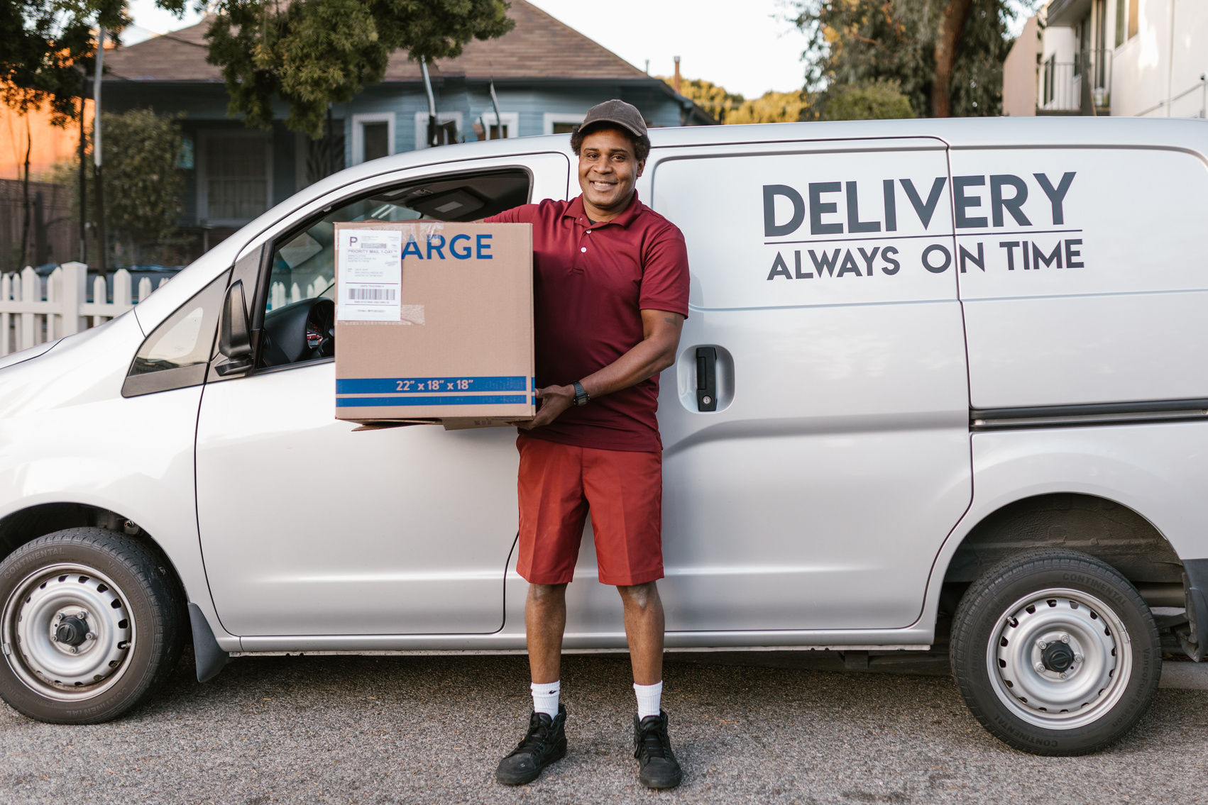

Adding a Parcel
Removing a Parcel
When the administrator is using stack operations to add a new parcel, the new parcel will be “pushed” at the top of the list. Then, when the user is using queue operations, the new parcel will be added at the back of the list.
Administrators can delete existing parcels using either stack or queue operations. When the user is using stack operations to delete an existing parcel, the parcel will be “popped” from the top of the list. Then, when the user is using queue operations, the parcel will be removed from the front of the list.

Slide 7



User Guide
To understand better, let’s dive in our system functionability.

Slide 8
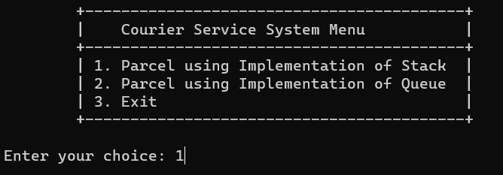
Main Menu
Main Menu have 3 options: stack operations, queue operations and exiting the program.
Case 1 chosen

Slide 9
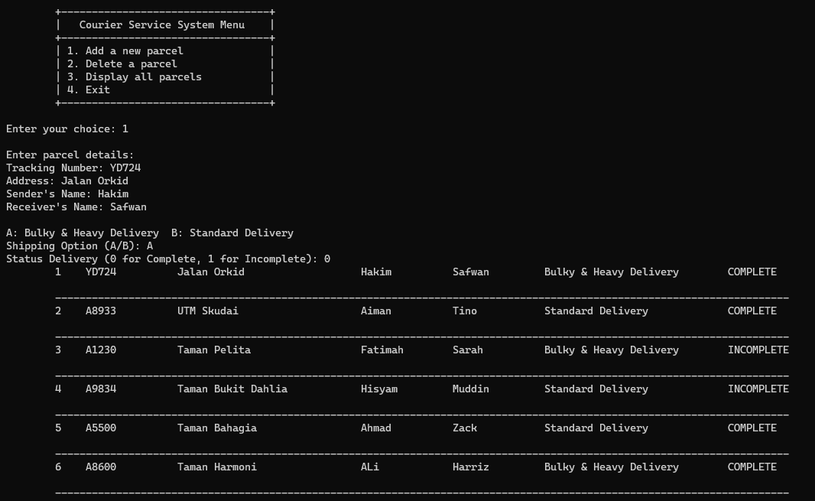
Stack Operations
Stack Implementation have 4 options: adding a new parcel at the top of stack, removing a parcel from the top of stack, display lists of parcels and exiting the program.
Case 1 chosen

Slide 10
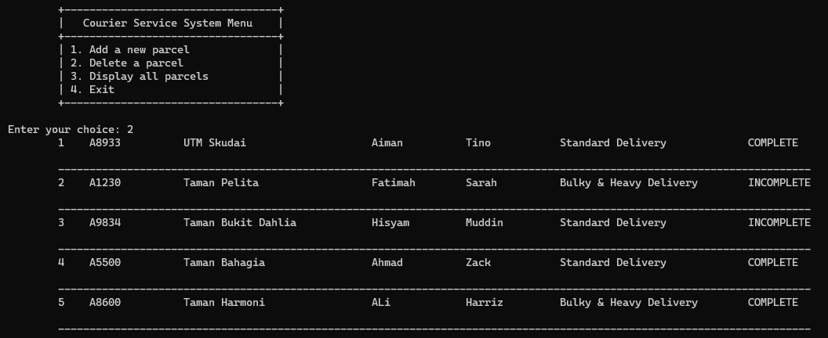
Stack Operations
Stack Implementation have 4 options: adding a new parcel at the top of stack, removing a parcel from the top of stack, display lists of parcels and exiting the program.
Case 2 chosen

Slide 11

Stack Operations
Stack Implementation have 4 options: adding a new parcel at the top of stack, removing a parcel from the top of stack, display lists of parcels and exiting the program.
Case 3 chosen

Slide 12
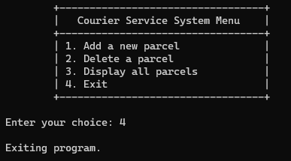
Stack Operations
Stack Implementation have 4 options: adding a new parcel at the top of stack, removing a parcel from the top of stack, display lists of parcels and exiting the program.
Case 4 chosen

Slide 13
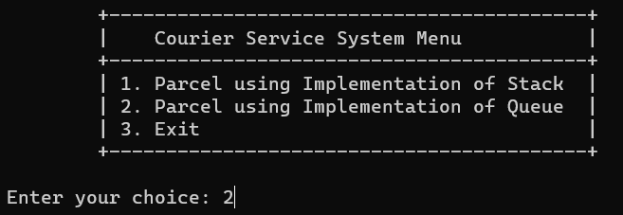
Main Menu
Main Menu have 3 options: stack operations, queue operations and exiting the program.
Case 2 chosen

Slide 14
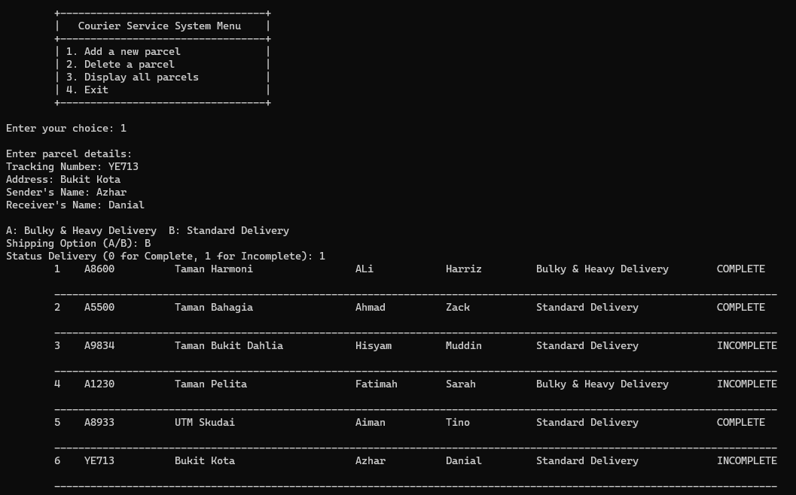
Queue Operations
Stack Implementation have 4 options: adding a new parcel at the back of queue, removing a parcel from the front of queue, display lists of parcels and exiting the program.
Case 1 chosen

Slide 15
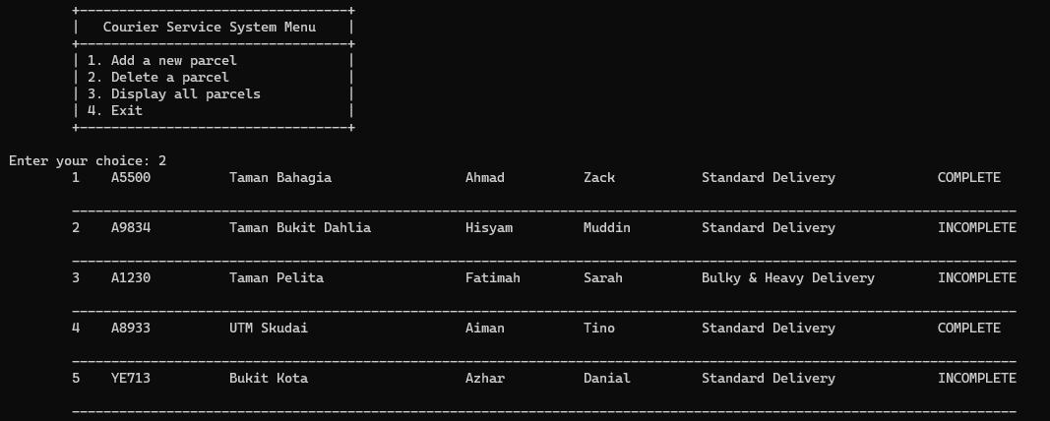
Queue Operations
Stack Implementation have 4 options: adding a new parcel at the back of queue, removing a parcel from the front of queue, display lists of parcels and exiting the program.
Case 2 chosen

Slide 16

Queue Operations
Stack Implementation have 4 options: adding a new parcel at the back of queue, removing a parcel from the front of queue, display lists of parcels and exiting the program.
Case 3 chosen

Slide 17
Queue Operations
Stack Implementation have 4 options: adding a new parcel at the back of queue, removing a parcel from the front of queue, display lists of parcels and exiting the program.
Case 4 chosen

Slide 18
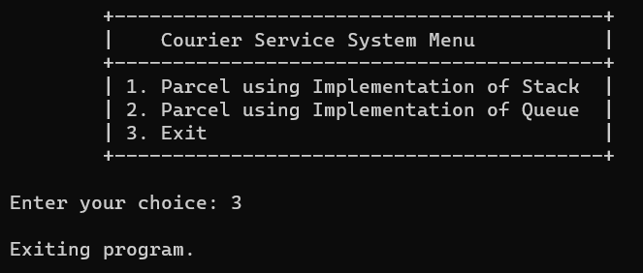
Main Menu
Main Menu have 3 options: stack operations, queue operations and exiting the program.
Case 3 chosen

